Slide 1
Lecture 8 泊松回归

Slide 2
GLMs for count data
Response/outcome variable Y is a count.
Examples:
Number of visits to a mall during December
Number of traffic accidents in a month, etc.
Typically, these counts have a few characteristics in common:
The counts occur over some fixed area or observation period
The things we are counting are often rare (or at least not especially numerous)

Slide 3
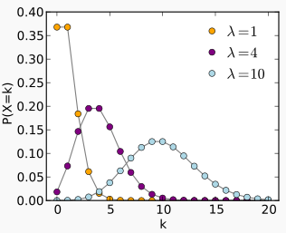
Poisson distribution

Slide 4
When Explanatory Variable(s) are numerical/continuous
Y ~independent Poisson distribution and we are interested in E(Y ) = μ.
The Poisson regression model for counts (with a log link) is
log(μ) = x^{T}β
i.e., μ=exp(x^{T}β)

Slide 5
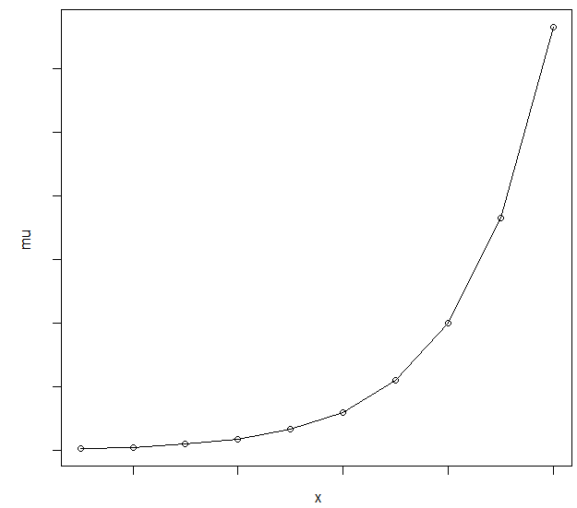
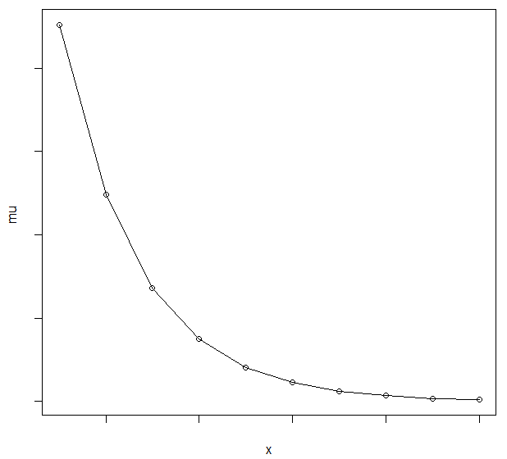
β > 0
β < 0

Slide 6
Interpretation of Parameter Estimates
exp(α) = effect on the mean of Y, that is μ, when X = 0
exp(β) = with every unit increase in X, the predictor variable has multiplicative effect of exp(β) on the mean of Y, that is μ
If β = 0, then exp(β) = 1, and the expected count, μ = E(y) = exp(α), and Y and X are not related.
If β > 0, then exp(β) > 1, and the expected count μ = E(y) is exp(β) times larger than when X = 0
If β < 0, then exp(β) < 1, and the expected count μ = E(y) is exp(β) times smaller than when X = 0

Slide 7

Maximum likelihood Estimation
Given the distribution of Y_{i}, we can formulate the likelihood function
That is, based on log-likelihood function, β can be estimated as MLE,
with in the log-likelihood function .

Slide 8
Deviance: A goodness of fit statistic

Slide 9
Deviance for model comparison
For nested two models,

Slide 10
Pseudo R square
which represents the proportional improvement in the log-likelihood function due to the terms in the model of interest, compared with the minimal model.

Slide 11
Other goodness of fit statistics: AIC and BIC
AIC and BIC are other goodness of fit statistics based on the log-likelihood function with adjustment for the number of parameters estimated and for the amount of data.
The model with the smaller value of AIC or BIC would be preferred.

Slide 12
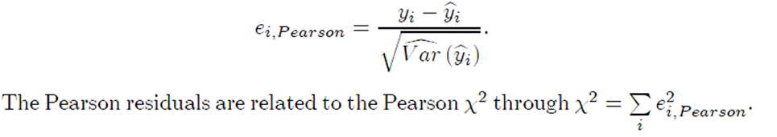
Diagnostic: residuals
In general linear models, a residual is the difference between the observed value of y and the fitted value .
Pearson residual:
In a Poisson model,

Slide 13
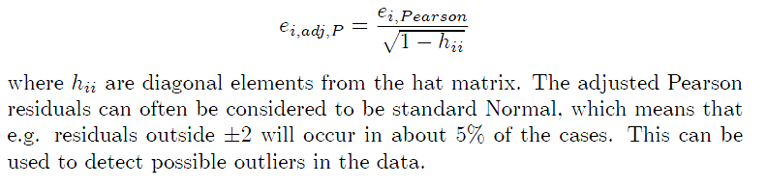
Standardized Pearson residual:

Slide 14

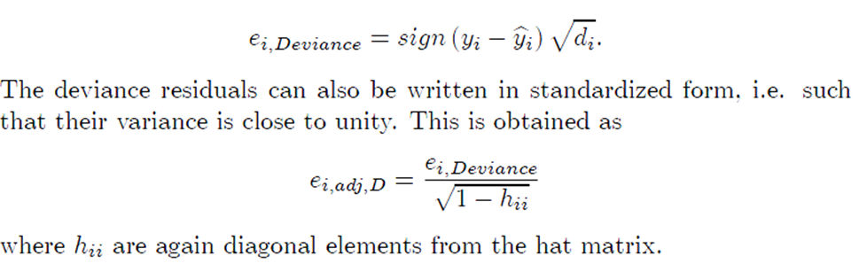
Deviance residuals
Remember
We define the deviance residuals as

Slide 15
Residual plot
A plot of residuals against the fitted values
A plot of residuals against covariates
should show a pattern where the residuals have a constant mean value of 0 and a constant range. Deviations from this “random” pattern may arise because of incorrect link function; omission of non-linear terms in the linear predictor and etc.
Plotting the residuals in the order the observations are given in the data may help to detect possible dependence between observations.
A normal probability plot of the residuals plots the sorted residuals against their expected values.

Slide 16
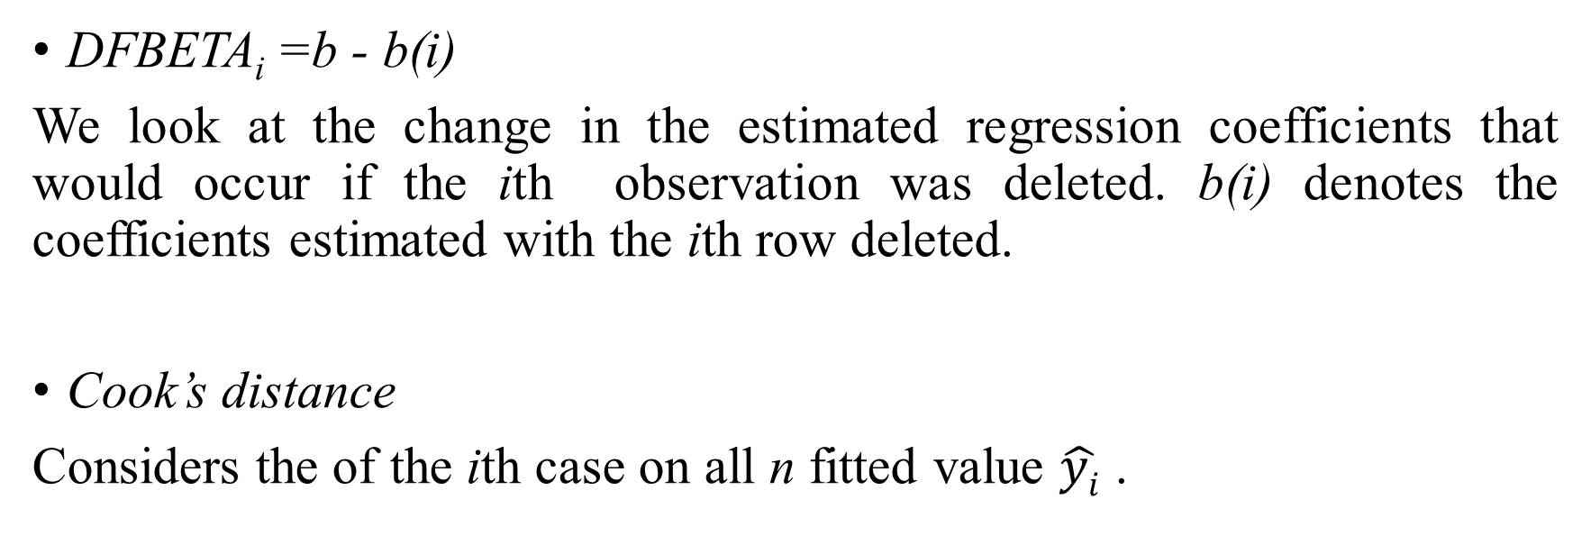
Detecting influential observations
DFBETA_{i}=b - b(i)
We look at the change in the estimated regression coefficients that would occur if the ith observation was deleted. b(i) denotes the coefficients estimated with the ith row deleted.
Cook’s distance
Considers the of the ith case on all n fitted value $\hat{yi}$ .

Slide 17
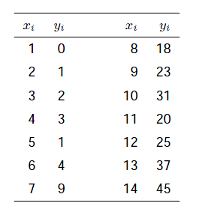
Example: Number of Deaths Due to AIDs
Data: the number of deaths due to AIDS in certain area per month period
y_{i} = number of deaths
x_{i} = time point (quarter)

Slide 18
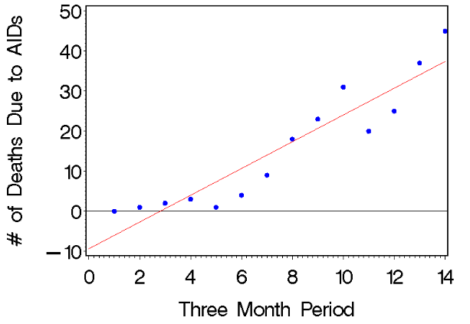
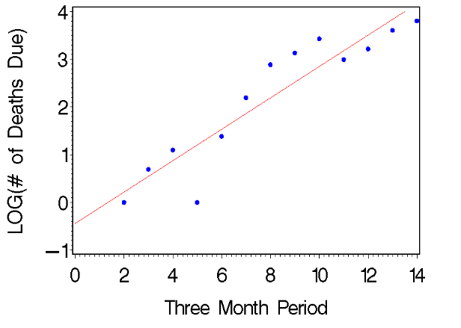

Slide 19
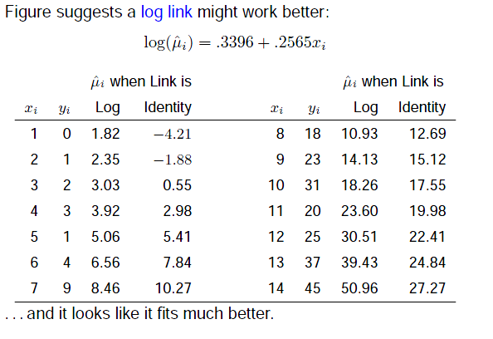

Slide 20
Interpretation
Question: for a 1-unit increase in month, how much does the expectation (or mean) number of AIDs deaths increase?
by a factor of exp (0.2565)=1.292.
That is, the number of deaths is growing at the rate of 29% per month.

Slide 21
Example
Lumber company interested in the relationship between the number of customers of a store and
X1 : Number of housing units
X2 : Average income
X3 : Average age
X4 : Distance to nearest competitor
X5 : Distance to store

Slide 22
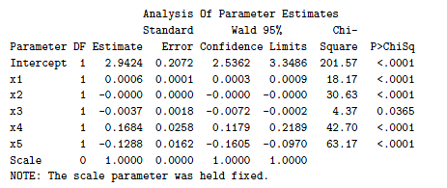


Slide 23
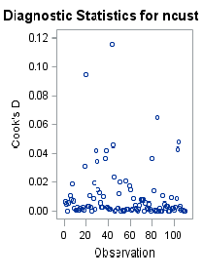
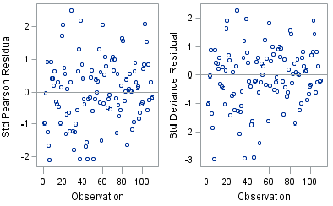
Residual Plots and Cook’s distance

Slide 24
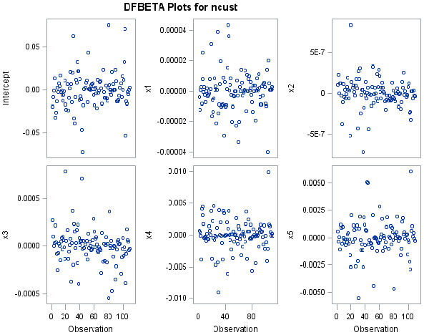

Slide 25


Poisson Regression for Rate Data
Events may occur over time or space (exposure).
For example:
Y=count
t=days
The Poisson regression model with log link for the expected rate of occurrence is
The term “log(t)” is an adjustment term. It is called the offset.

Slide 26
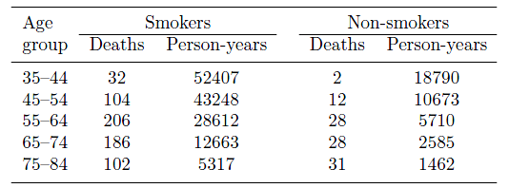
Example
The data are from a famous study conducted by Sir Richard Doll and colleagues, in which, doctors were sent a brief questionnaire about whether they smoked. Since then information about their deaths has been collected. Table shows the numbers of deaths from coronary heart disease among male doctors 10 years after the survey. It also shows the total number of person-years of observation at the time of the analysis

Slide 27
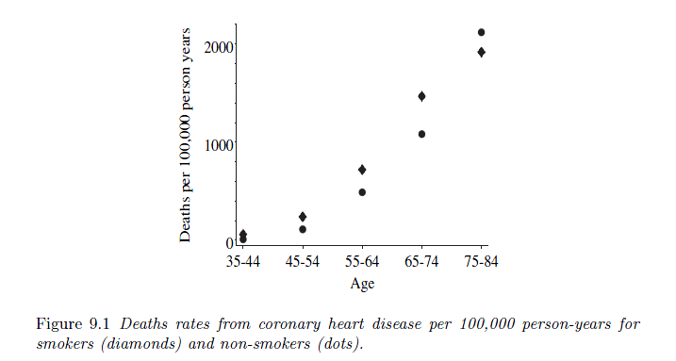

Slide 28

Model:
The term deaths_{i} denotes the expected number of deaths
personyears_{i} denotes the number of doctors at risk and the observation periods in group I
smoke_{i} is equal to 1 for smokers and 0 for non-smokers
agecat_{i} takes the values 1, . . . , 5 for age groups 35–44,. . .,75–84
agesq_{i} is the square of agecat_{i} to take account of the non-linearity of the rate of increase
smkage_{i} is equal to agecat_{i} for smokers and 0 for non-smokers; thus, describing a differential rate of increase with age

Slide 29
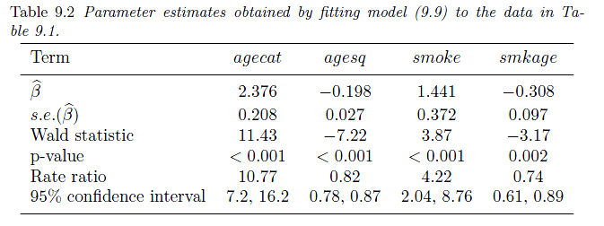
The estimates show that the risk of coronary deaths was, on average, about 4 times higher for smokers than non-smokers (based on the rate ratio for smoke), after the effect of age is taken into account. However, the effect is attenuated as age increases (coefficient for smkage).

Slide 30
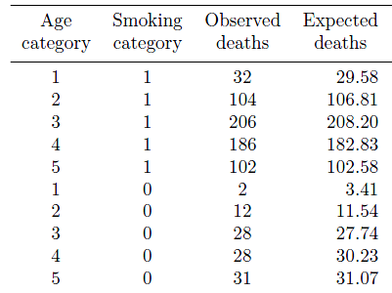
The maximum value of the log-likelihood function for the minimal model (with only one parameters, β₁ ) is −495.067 and for the fitted model is −28.352,
Pseudo R²=？AIC=?
The maximum value of the log-likelihood function for the maximal model is -27.535.
The deviance for the fitted model? which is small compared with the chi-squared distribution with N − p = 10 − 5 = 5 degree of freedom.

Slide 31
Over dispersion
One “feature” of a Poisson distribution is that the mean=variance=µ.
When the data observed have a variance greater than predicted under the GLM, we have over dispersion.
Testing for over dispersion in Poisson data
If Deviance/df >1, then over dispersion may be present
If Deviance/df <1, then under dispersion may be present
If the data are overdispersed or underdispersed relative to a poisson distribution then we need to correct for this in some way. One approach is to multiply the estimated variance by φ yielding what's called a quasi-poison model.

